Slide 1

Smt. Kashibai Navale College of Engineering
Department of Information Technology
Project Title:
“Analyzing And Predicting The Success Of Box Office Collection Of A Movie using Machine Learning”
PROJECT DOMAIN: Data Science and Machine Learning
Guide :
Mrs. Varsha Khandekar Mam
BY :
B20138 Shubham Jain
B20142 Sanyam Jatale
B20161 Sanket Mokate
B20162 Rohan Moze
Notes:
1

Slide 2
Motivation
What if we could be determine movie’s box office collection prior to its release?
It would be great for movie directors and producers to imply some Business Decision based on predictions.
Many factors influence success or failure of movie:
Cast
Director
Gross
Budget
Runtime
Genre
So, we are going to implement a model that would predict movie box office collection

Slide 3
Problem Statement
To Develop A Model That Can Predict The Success Of Box Office Collection Of A Movie Using Machine Learning

Slide 4
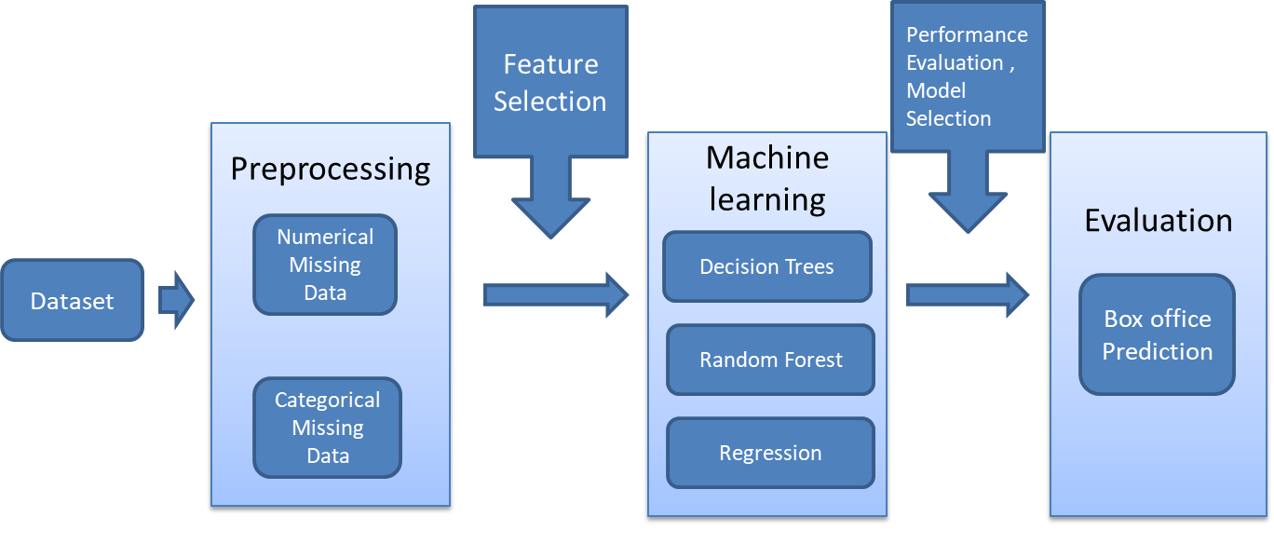
System Architecture
Fig . System architecture

Slide 5
Methodologies
Dataset Extraction
Dataset Cleansing
Data Preprocessing
Decision Trees
Random Forest Classifier
Regression
Machine learning
Accuracy of the model
Classification Matrix
Performance
Evaluation

Slide 6
DATA PREPROCESSING:
DATASET:
Dataset Size : 5040 movies from year 1986 - 2016
-> In this dataset we have nominal data attributes as well as discrete data attributes.
-> For the purpose of prediction we are going to create interval variable(or classes).
Features :
'color' , ‘director_name' , 'num_critic_for_reviews', 'duration' , 'director_facebook_likes' , 'actor_3_facebook_likes' , 'actor_2_name' , 'actor_1_facebook_likes' , 'gross' , 'genres' , 'actor_1_name' , 'movie_title' , 'num_voted_users', 'cast_total_facebook_likes', 'actor_3_name' , 'facenumber_in_poster' , 'plot_keywords' , 'movie_imdb_link' , 'num_user_for_reviews' , 'language' , 'country' , 'content_rating' , 'budget','title_year' , 'actor_2_facebook_likes' , 'imdb_score' , 'aspect_ratio' , 'movie_facebook_likes'

Slide 7
Data Feature Elimination And Analysis:
Acquire the dataset suitable for the prediction purpose and having appropriate features.
Data pre-processing is a data mining technique which is used to transform the raw data in a useful and efficient format.
Data cleaning
Fill in the missing values
Using functions as following:
isnull()
fillna()
median()
mode()
Drawing out some important features based on the feature elimination technique and feature importance.

Slide 8
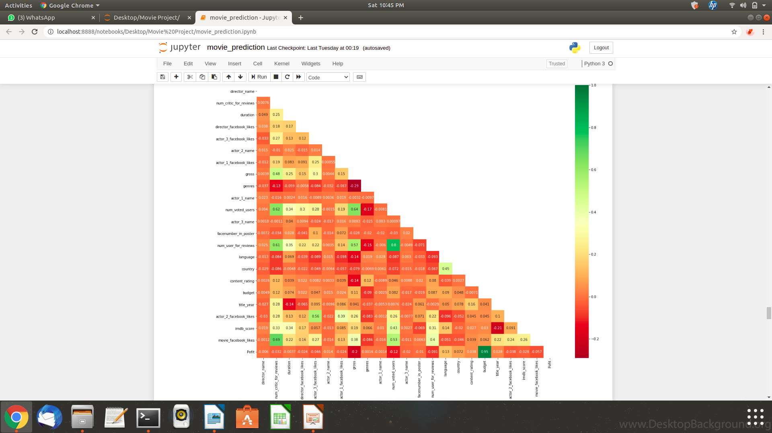
Visualization of data features are done in order to know the relationship and dependencies based on the graphs.
Drawn Correlation heatmap for checking the multicollinearity of the features that would help us in dropping the inappropriate features.

Slide 9
Machine learning
After data pre processing and data exploration we’ll apply machine learning algorithms to our dataset.
Following supervised M/L algorithms are going to be used :
Regression Model
Decision trees
Random Forest
With every attempt of algorithm accuracy and efficiency of the algorithm is going to be determined, whether the algorithm fits best for the prediction or not.

Slide 10
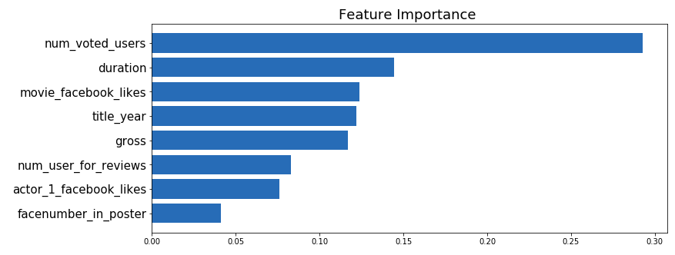
For applying Supervised ML algorithm we have input and output feature , then we will divide our dataset to train_set and test_set (using train_test_split())so that our model could precisely learn to predict.
We have 4918 rows with selected features
Train set
Test set
Determining the suitable features for the prediction purpose :

Slide 11
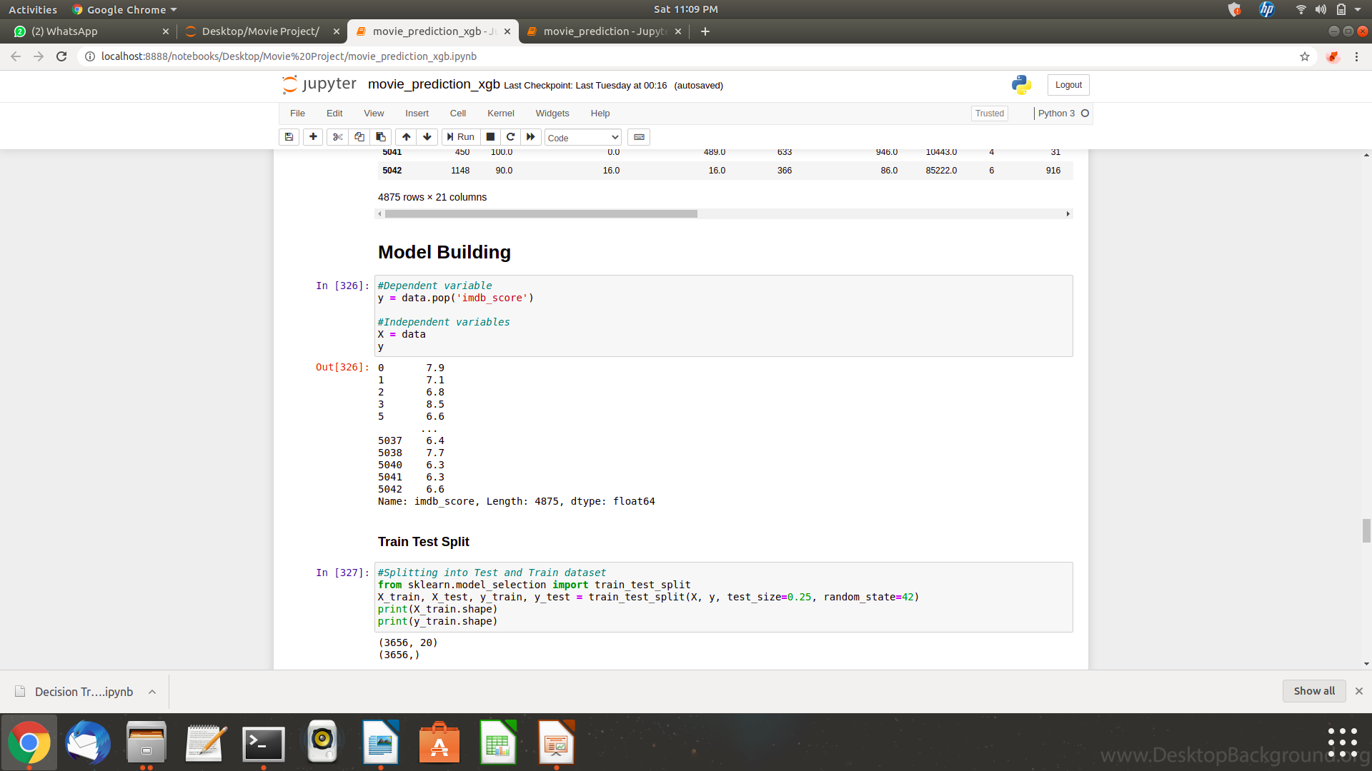
Target Variables :
Regression Model :
imdb_score (a numerical value in the range of 1 - 10)
Random Forest Classifier : success (labels = [‘FLOP’ , ‘AVG’ , ‘HIT’])
Success | Labels | Bins
 | Hit | 6 – 10
 | Avg | 3 – 6
 | Flop | 1 – 3

Slide 12
Decision Tree Classifier : box-office (categorized into 7 classes within the range of gross value)
 | Labels | Bins
 | ‘C1’ | $0 - $40M
 | ‘C2’ | $40M - $80M
gross_class | ‘C3’ | $80M - $150M
 | ‘C4’ | $150M - $200M
 | ‘C5’ | $200M - $250M
 | ‘C6’ | $250M - $500M
 | ‘C7’ | $500M - $1000M

Slide 13
Performance Evaluation :
Accuracy :
It provides how precisely the model predicts the output when test data is given.
S.No | Test_size | HIT | AVG | FLOP | Accuracy
1. | 25% | 3314 | 1516 | 45 | 80%
2. | 25% | 1482 | 1832 | 1561 | 64%
3. | 25% | 3314 | -- | 1561 | 78%
4. | 30% | 3314 | 1516 | 45 | 80%
5. | 30% | 1482 | 1832 | 1561 | 64%
In Case of Random Forest Classifier

Slide 14
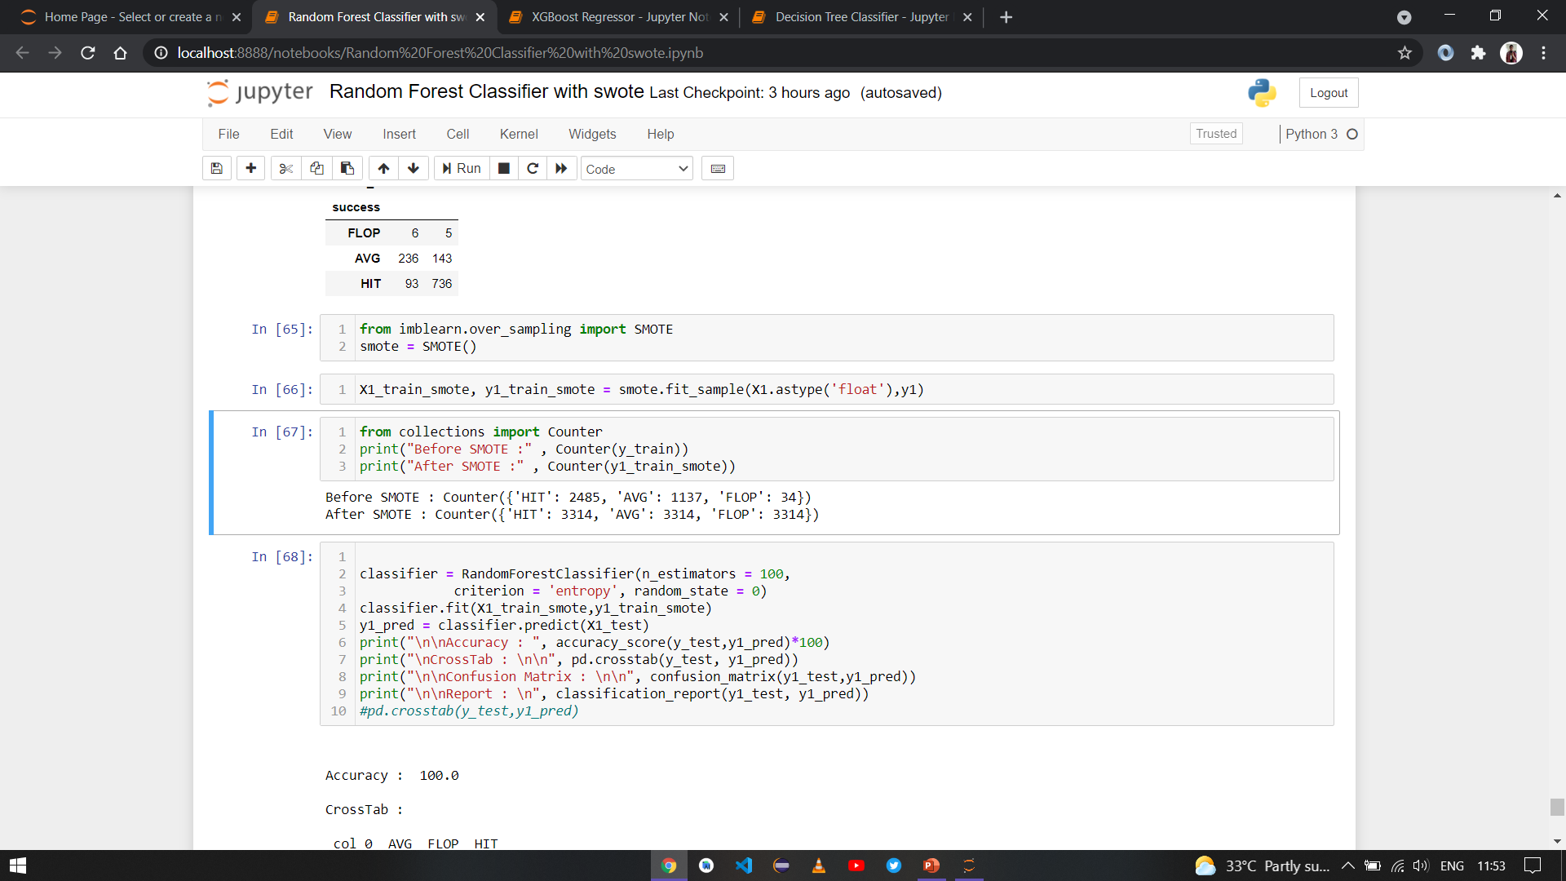
SMOTE(Synthetic Minority Over-sampling Technique):
 | Precision | Recall | f1-score | support
C1 | 0.86 | 0.87 | 0.87 | 690
C2 | 0.38 | 0.46 | 0.42 | 140
C3 | 0.28 | 0.20 | 0.77 | 89
C4 | 0.21 | 0.09 | 0.13 | 32
C5 | 0.12 | 0.22 | 0.16 | 9
C6 | 0.53 | 0.33 | 0.41 | 24
C7 | 0.00 | 0.00 | 0.00 | 0
accuracy |  |  | 0.71 | 984
Macro avg | 0.34 | 0.31 | 0.32 | 984
Weighted avg | 0.71 | 0.71 | 0.71 | 984
In Case of Decision Tree Classifier (gross range)
Used to solve imbalanced dataset.
It aims to balance class distribution by randomly increasing minority class examples by replicating them.

Slide 15
No of features (Test size) | Grid_search (Yes / No) | Mean Absolute Error | Model Score | R2 Score | Accuracy
6 (25) | No | 0.57 | 0.914 | 0.483 | 89.16%
 | Yes | 0.55 | 0.752 | 0.508 | 89.34%
6 (30) | No | 0.58 | 0.924 | 0.471 | 89.18%
 | Yes | 0.56 | 0.671 | 0.509 | 89.39%
All (25) | No | 0.55 | 0.974 | 0.525 | 89.57%
 | Yes | 0.52 | 0.842 | 0.563 | 89.9%
All (30) | No | 0.56 | 0.977 | 0.515 | 89.57%
 | Yes | 0.52 | 0.847 | 0.56 | 90.04%
In Case of Regression Model [XGBoost Model] - (imdb_score)

Slide 16
Conclusion
Thus, using machine learning tools for analysing movie reviews box office production companies can get a pre-release analysis which can be very useful in further decisional aspects.
The system will predict an approximate success rate of a movie based on its profitability by analyzing historical data.
For future work, we can add trailer hit count and social media hive, news trending and release date, vacation of years to this system to get the system more mature for prediction.
As based on further technology and learning, the accuracy for prediction of gross value range (decision tree classifier) can be increased.

Slide 17
References
[1]Steven Yoo, Robert Kanter, David Cummings TA, Andrew Mass, “Predicting Movie Revenue from IMDB Data”, pp. 1-0 ,2015 http://cs229.stanford.edu/proj2011/YooKanterCummings-PredictingMovieRevenuesUsingImdbData
[2]Nevon Project “Movie Success Prediction Using Data Mining” [Online] Available: http://nevonprojects.com/movie-success-prediction-using-data-mining/ [Accessed: 10Dec-17] https://www.researchgate.net/publication/332396741_Movie_Success_Prediction_using_Data_Mining_For_Data_Mining_and_Business_IntelligenceITA5007_of_Master_of_Computer_Application_School_Of_Information_Technology_and_Engineering
[3]Statistical approach for predicting imdb https://www.kaggle.com/bharathraja/statistical-approach-for-predicting-imdb
[4]Machine learning approach for movie box-office prediction. https://www.kaggle.com/rahuljain98.

Slide 18
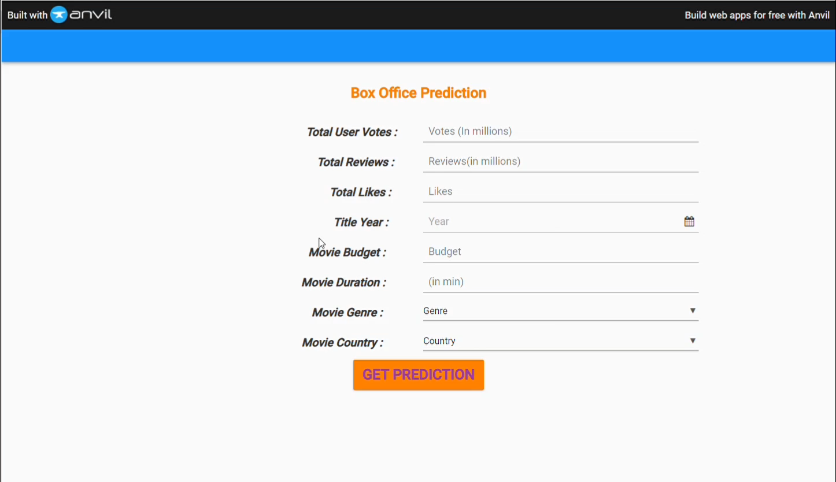

Slide 19
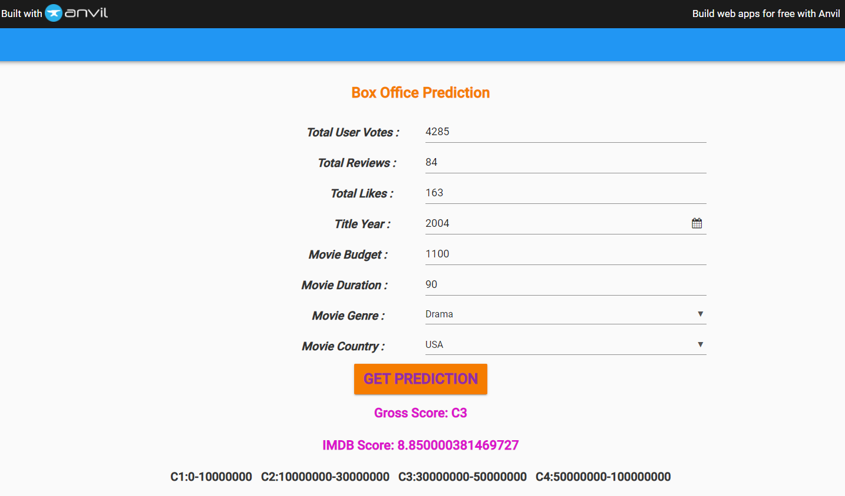

Slide 20







THANK YOU
!! Thank you !!
Notes:
20

